Slide 1


RAMCO INSTITUTE OF TECHNOLOGY,
RAJAPALYAM
ANNA UNIVERSITY: CHENNAI 600 025
JUNE 2023
MINI PROJECT VIVA-VOCE EXAMINATIONS
(R-2017)
Academic Year : 2022-2023(Even Semester)
Degree & Branch : B.E- Computer Science and Engineering
Semester : VI
Course Code : CS8611
Title : Project Work
Date & Session : JUNE 2,2023 & FN
Batch Number : B19

Slide 2
SPEECH AUDIO EMOTION RECOGNITION USING DEEP LEARNING
PRESENTED BY :
GUIDED BY :
MUTHU KUMAR K
Mr.K.VIGNESH SARAVANAN
AP(SG)/CSE

Slide 3
CONTENTS
Introduction
Problem Identification
Project Objectives
Methodology
Results
Conclusion
Future Work
References

Slide 4
INTRODUCTION
The emotion recognition aims to find the emotional condition of an individual by his/her speech audio.
Speech is the fast and best normal way of communicating against human. This reality motivate us to consider speech signal as a quick and effective process to identify a human behavior and mentality.
It is most beneficial for applications ,which need Human-Computer interaction such as customer service, education, forensics, crime departments, medical analysis etc.,

Slide 5
PROBLEM IDENTIFICATION
Emotion recognition from speech can assist in monitoring and assessing individuals' mental health by detecting changes in emotional states.
Emotion recognition enables systems to understand and respond to users' emotional states, leading to more personalized and empathetic interactions with voice assistants, chatbots, and other interactive systems.
It can enhance assistive technologies, making interactions more intuitive and natural for individuals with disabilities or special needs.

Slide 6
PROJECT OBJECTIVES
To detect the emotions of individuals with speech audio
The objective is to make the model invariant to perturbations faced by the existing solutions and enhance its ability to produce efficient prediction
Deep Learning Algorithms have been used to implement the proposed techniques.
To use higher intelligent Artificial Neural Network to classify the emotions

Slide 7
BASE PAPER
Authors and year | Journal Name | Methodology | Scope
Chen Jie,2021 | Speech Emotion Recognition Based On Convolutional Neural Network | Convolutional Neural Network and Mel- Frequency Cepstral Coefficient | The Convolutional Neural Network architecture is designed to capture local and global dependencies in speech signals, facilitating the extraction of emotion- related features.

Slide 8
METHODOLOGY
6/02/2023
RAMCO INSTITUTE OF TECHNOLOGY
8

Slide 9
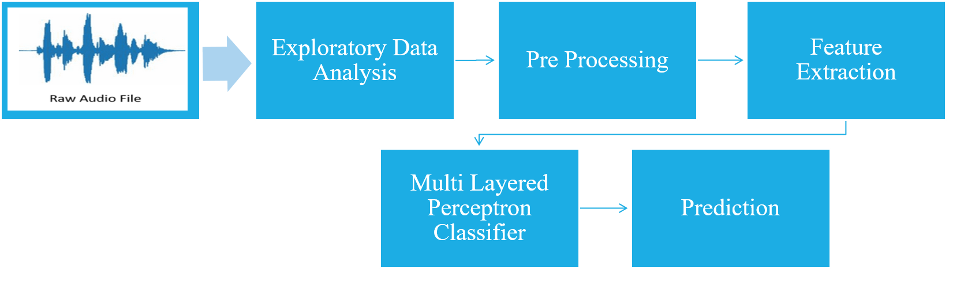
WORK FLOW
6/02/2023
RAMCO INSTITUTE OF TECHNOLOGY
9

Slide 10
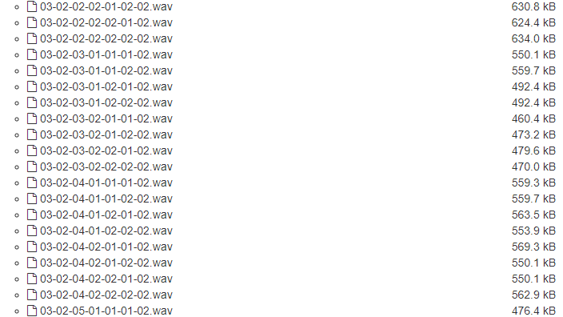
DATASET COLLECTION
The Dataset is collected from the Repository “ZENODO” https://zenodo.org/record/1188976. This is a popular dataset used in audio related projects.
6/02/2023
RAMCO INSTITUTE OF TECHNOLOGY
10

Slide 11
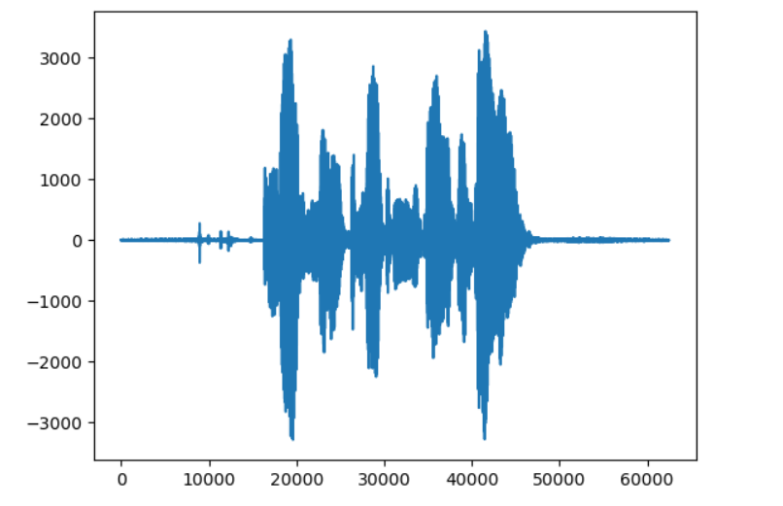

EXPLORATORY DATA ANALYSIS
Number of Files : 7356 RAVDESS files
Total Size : 24.8 GB
Number of Actors Involved : 24(Both Male and Female)
Modality Formats : Audio-only , Audio-Video , Video-only
6/02/2023
RAMCO INSTITUTE OF TECHNOLOGY
11

Slide 12
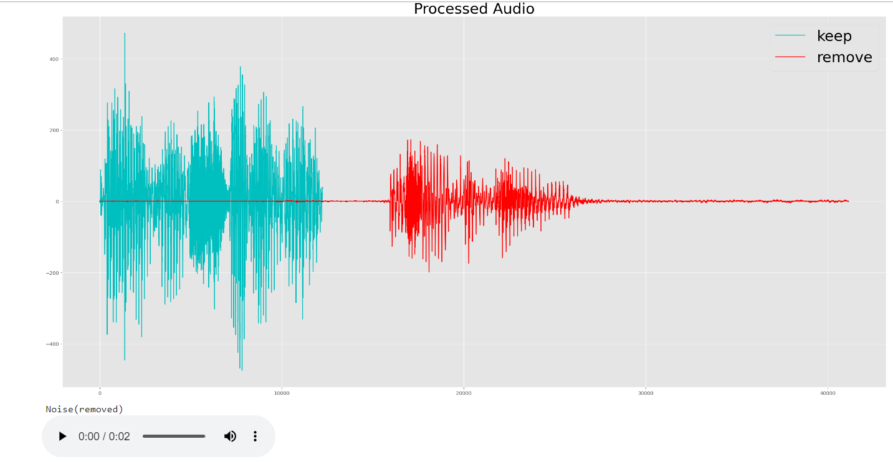
RESULT OF PREPROCESSING
6/02/2023
RAMCO INSTITUTE OF TECHNOLOGY
12

Slide 13
FEATURE EXTRACTION
Mel Spectrogram
Mel Frequency Cepstral Coefficient
Zero Crossing Rate
Spectral Flux
Spectral Rolloff
Chroma Vector
Features to be extracted:
6/02/2023
RAMCO INSTITUTE OF TECHNOLOGY
13

Slide 14
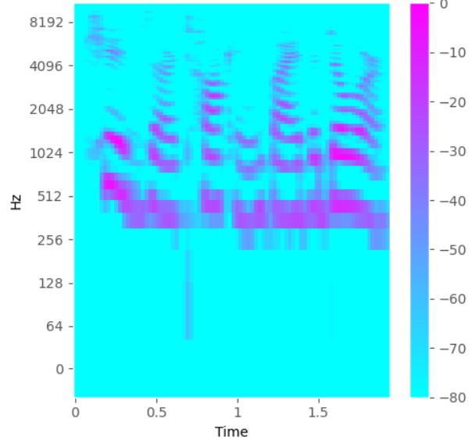
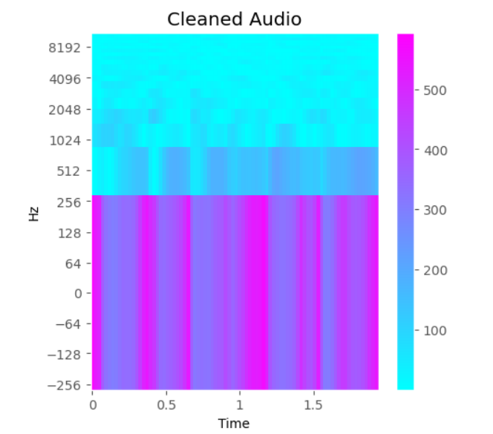
RESULTS OF FEATURE EXTRACTION
MEL SPECTROGRAM MEL FREQUENCY CEPSTRAL COEFFICIENTS
6/02/2023
RAMCO INSTITUTE OF TECHNOLOGY
14

Slide 15
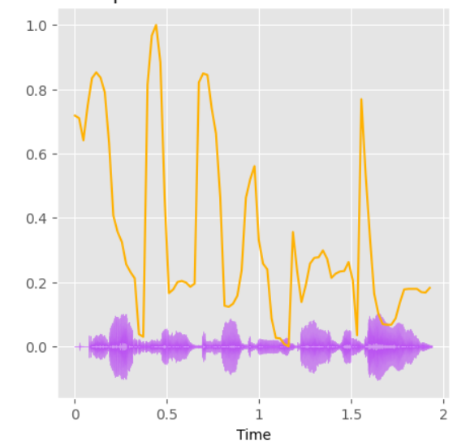
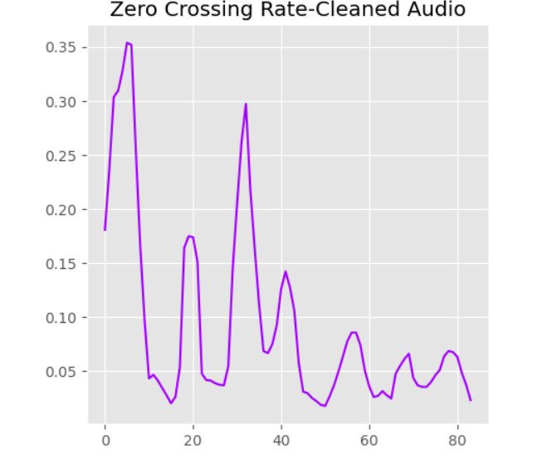
RESULTS OF FEATURE EXTRACTION(Contd..)
ZERO-CROSSING RATE SPECTRAL ROLLOFF
6/02/2023
RAMCO INSTITUTE OF TECHNOLOGY
15

Slide 16
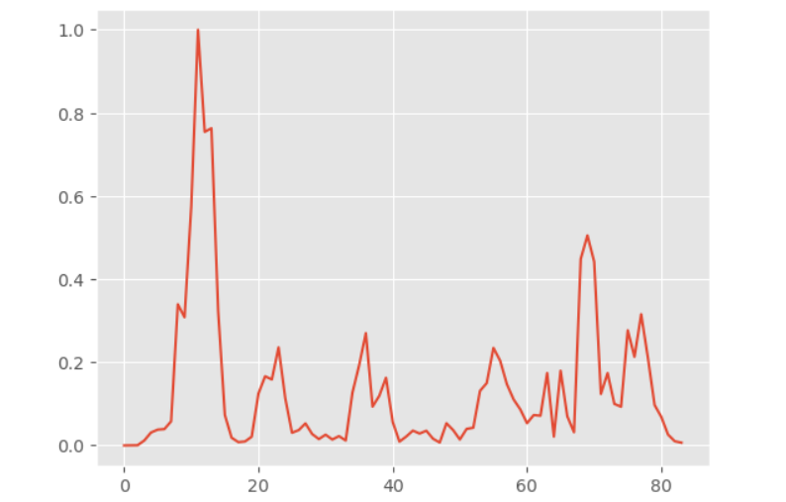
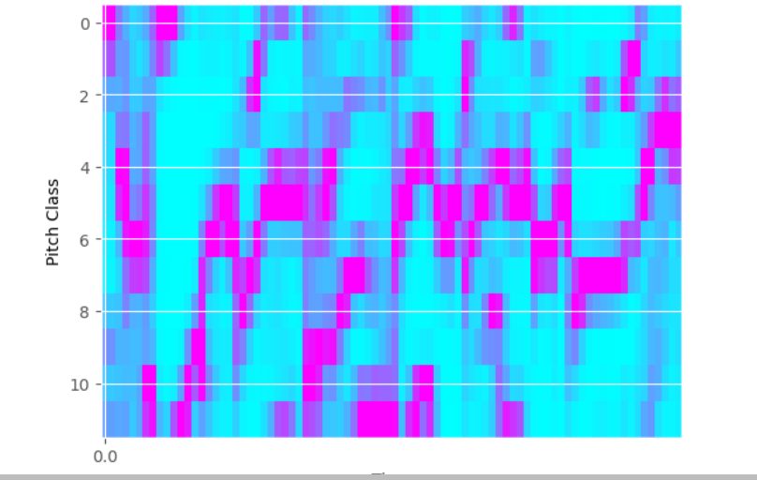
RESULTS OF FEATURE EXTRACTION(Contd..)
SPECTRAL FLUX CHROMA VECTOR
6/02/2023
RAMCO INSTITUTE OF TECHNOLOGY
16

Slide 17
MULTI LAYER PERCEPTRON CLASSIFIER
Multi-Layer Perceptron is a type of artificial neural network that consists of multiple layers of interconnected nodes, or artificial neurons.
It is a feedforward neural network, meaning that information flows through the network in one direction, from input nodes to output nodes.
The structure of an MLP typically includes an input layer, one or more hidden layers, and an output layer.
6/02/2023
RAMCO INSTITUTE OF TECHNOLOGY
17

Slide 18
MULTI LAYER PERCEPTRON CLASSIFIER(Contd..)
6/02/2023
RAMCO INSTITUTE OF TECHNOLOGY
18

Slide 19
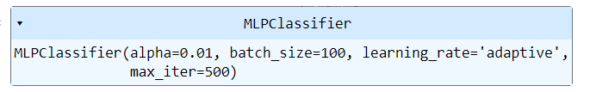
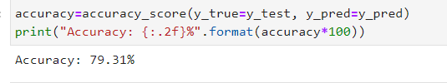
RESULTS OF PROPOSED SYSTEM
6/02/2023
RAMCO INSTITUTE OF TECHNOLOGY
19

Slide 20
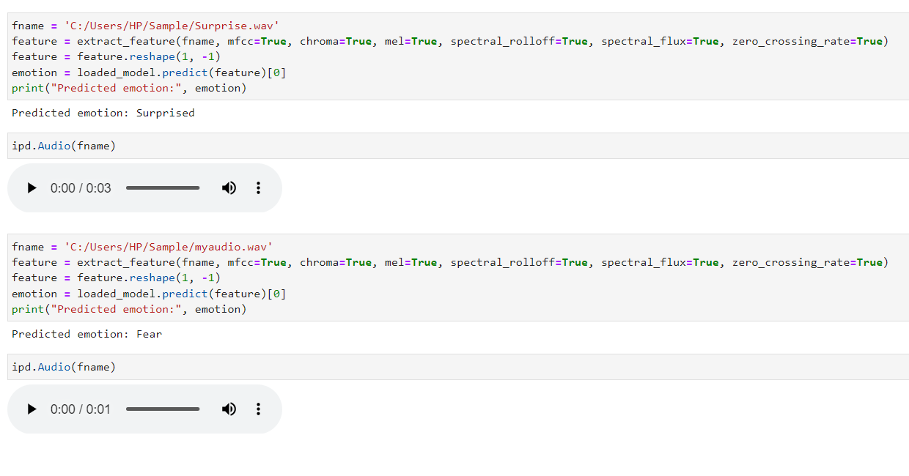
RESULTS OF PROPOSED SYSTEM
6/02/2023
RAMCO INSTITUTE OF TECHNOLOGY
20

Slide 21
CONCLUSION
Speech audio emotion recognition is a valuable technology that has the potential to enhance various applications such as sentiment analysis, human-computer interaction, and speech-based systems.
I have applied a classification technique using high intelligent deep learning models to classify the emotions.
Included features to efficiently classify emotions which is not included as features in the existing system.
6/02/2023
RAMCO INSTITUTE OF TECHNOLOGY
21

Slide 22
FUTURE WORK
Extending the system to perform real-time emotion recognition in streaming audio can open up new possibilities for applications such as emotion-aware virtual assistants or emotion-based content recommendation systems.
Expand the available dataset for training and evaluation. A larger and more diverse dataset can help improve the performance and generalization of the emotion recognition system.
6/02/2023
RAMCO INSTITUTE OF TECHNOLOGY
22

Slide 23
REFERENCES
C. Jie, "Speech emotion recognition based on convolutional neural network," 2021
International Conference on Networking, Communications and Information Technology
(NetCIT), Manchester
R. A. Khalil, E. Jones, M. I. Babar, T. Jan, M. H. Zafar and T. Alhussain, "Speech
Emotion Recognition Using Deep Learning Techniques: A Review," in IEEE Access
Muljono, M. R. Prasetya, A. Harjoko and C. Supriyanto, "Speech Emotion Recognition of
Indonesian Movie Audio Tracks based on MFCC and SVM," 2019 International
Conference on contemporary Computing and Informatics (IC3I), Singapore
6/02/2023
RAMCO INSTITUTE OF TECHNOLOGY
23

Slide 24
REFERENCES(Contd..)
Swain, M., Routray, A. and Kabisatpathy, P., 2018. Databases, features and classifiers
for speech emotion recognition: a review. International Journal of Speech Technology
Sezgin, M. C., Gunsel, B., & Kurt, G. K. (2012). Perceptual audio features for emotion
detection. EURASIP Journal on Audio, Speech, and Music Processing, 2012
A. B. Nassif, I. Shahin, I. Attili, M. Azzeh and K. Shaalan, "Speech recognition using
deep neural networks: A systematic review", IEEE Access
6/02/2023
RAMCO INSTITUTE OF TECHNOLOGY
24

Slide 25
THANK YOU
6/02/2023
RAMCO INSTITUTE OF TECHNOLOGY
25

